Slide 1
(title of this project)Energy Stocks or Sector ETF
If you want to invest or get exposure in energy space, should you invest in the largest/well known energy stocks or invest in ETF, which one is the best to invest for longer period?
framework

Slide 2
Team

Slide 3
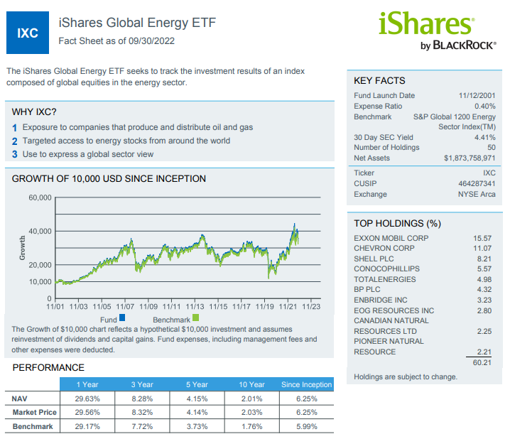
We are using this ETF as it tracks the investment results of the index composed of global equities in the energy sector
It gives a good picture of how energy sector performed
Top 4 holdings are :

Slide 4
Criteria
We compared monthly Cumulative Returns and Excess Return (alpha) against the IXC for the past 5 years
We calculated how frequent the 4 stocks outperforms the index ETF over the past 5 years
We used Beta to measure risk of the 4 stocks against the index ETF
We compared the Sharpe Ratios to measure performance of the 4 stocks and the ETF
Given how volatile the energy sector is, we used Sortino Ratio to measure how stocks/sector performed during economy drawdowns.

Slide 5
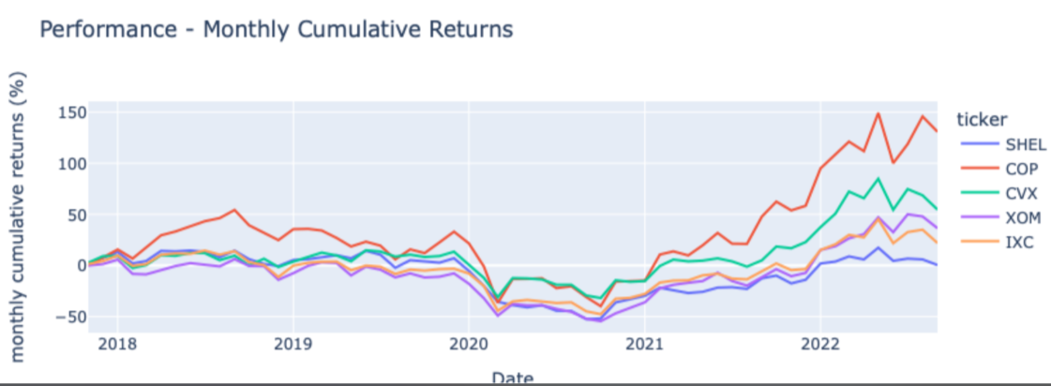
Stock/ETF performance

Slide 6
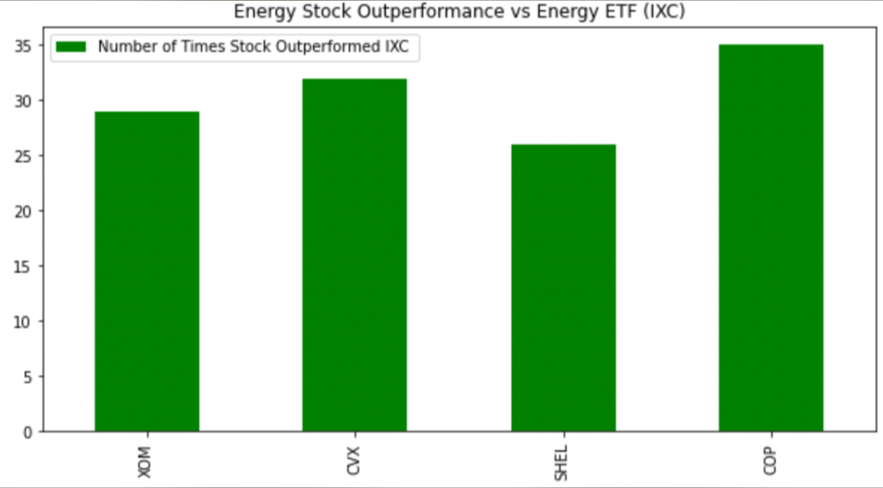
% outperformed
% for COP: 35%
Vs lowest: SHEL: x%

Slide 7
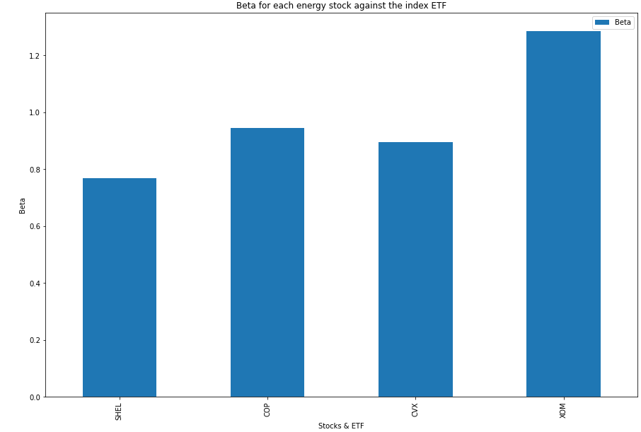
Risk/Volatility -Beta
SHEL has the lowest Beta against IXC with x %

Slide 8
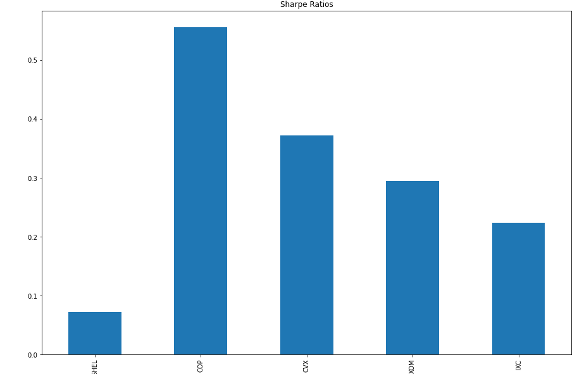
Sharpe Ratio- COP

Slide 9
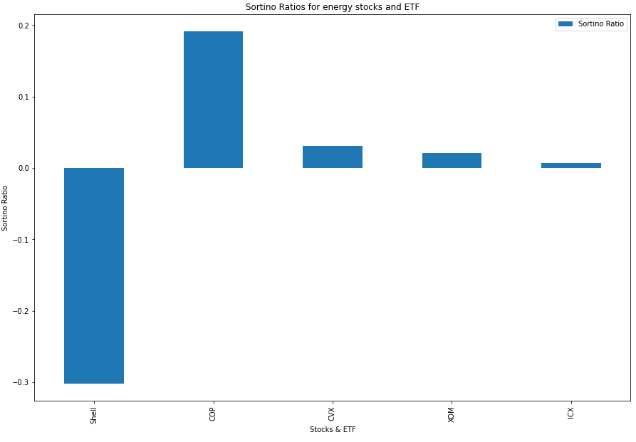
Sortino Ratio - COP

Slide 10
Conclusion

